Slide 1

Contents
Micro-Doppler and time frequency analysis (short recap)
mD in Narrowband vs Wideband radar, ‘cell migration’ effect
Received signal model from rotor blades
Futures extraction from drone’s spectrograms
Mapping of features from spectrograms to radar waveform
Verification of mD constraints on range restricted (1 km) FMCW radar (with the same assumptions made for the mean power computation)

Slide 2
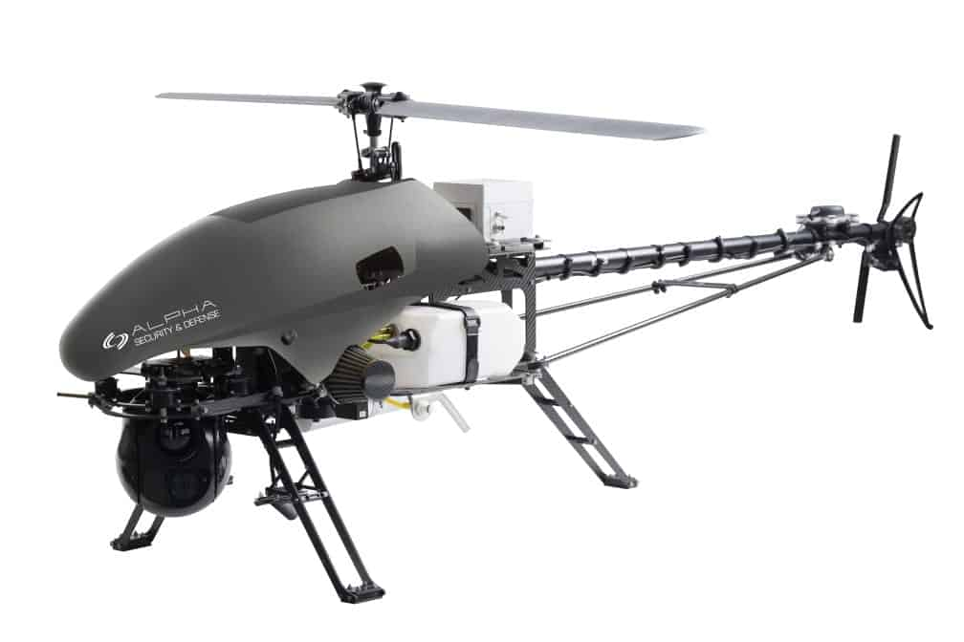
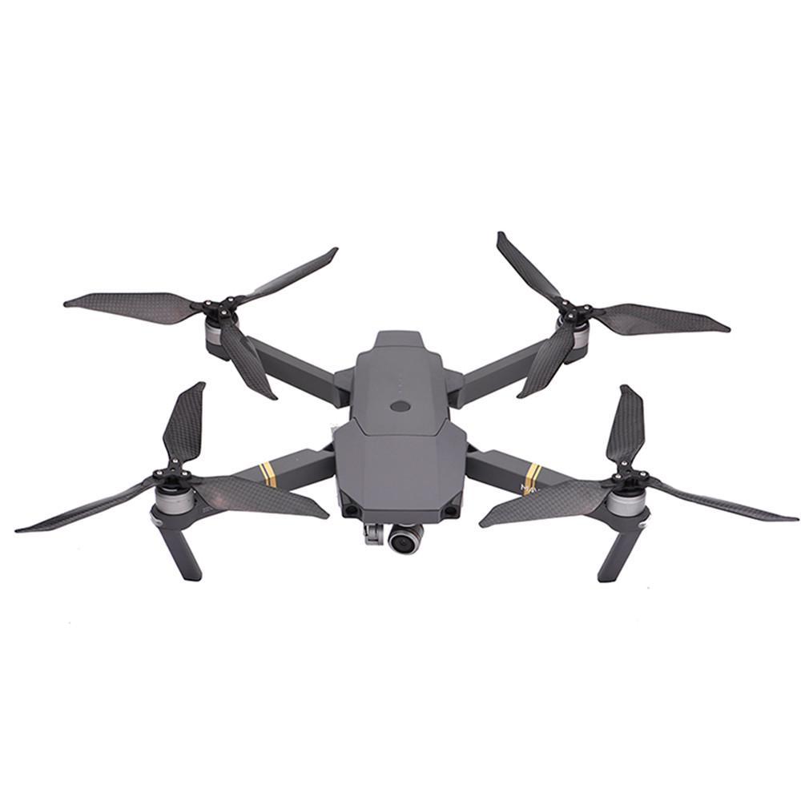



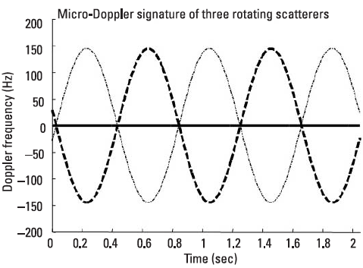





Time frequency analysis
Goal: classification
Unique feature of a drone that can be observed in the time-frequency domain
Rotor blades
Typical signal in BB received from target
$$f_{d}=$$
Approximating
Appl. Rodrigues Formulas

Slide 3
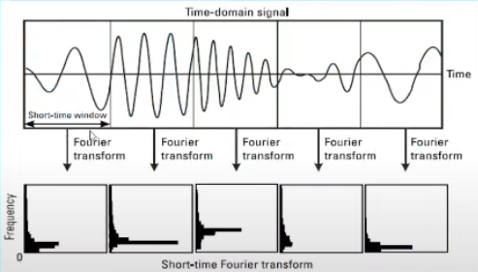
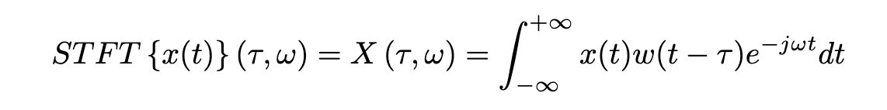
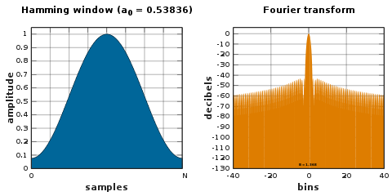
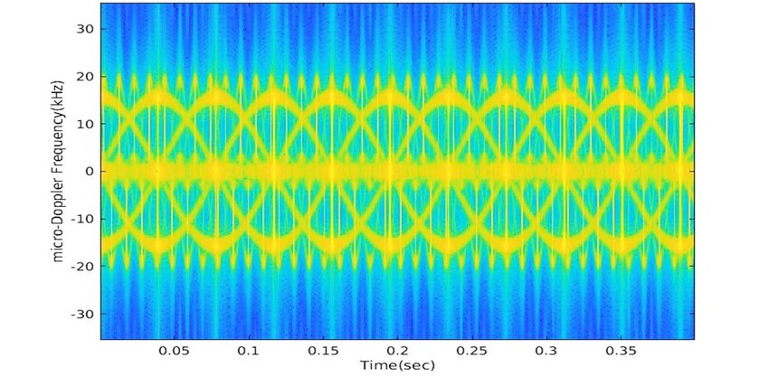

Spectrogram
How to obtain it?
The choice of a suitable window is critical for time and frequency resolution, usually Hamming window is used
Wide window –> Lower time res and Higher freq. res
Narrow window –> Higher time res and Lower freq. res

Slide 4
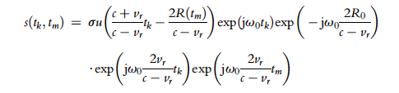



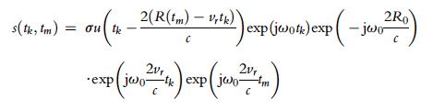




mD in Wideband radar
Total time of tx (Slow time)
Time of received echo
(fast time)
Radar time can be expressed as sum of slow time and fast time:
$$t=t_{m}+t_{k}$$
If we transmit a signal p(t), considering a target at distance R with a radial velocity v:
Approximated models
First order approx. -> ( $c −v_{r})$ $\sim c$
Stop and go approx. -> ($v_{r}$ $t_{k})$ $\sim 0$

Slide 5
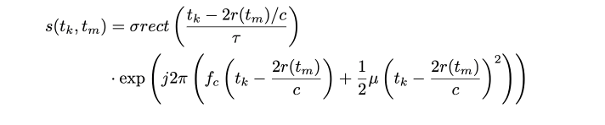





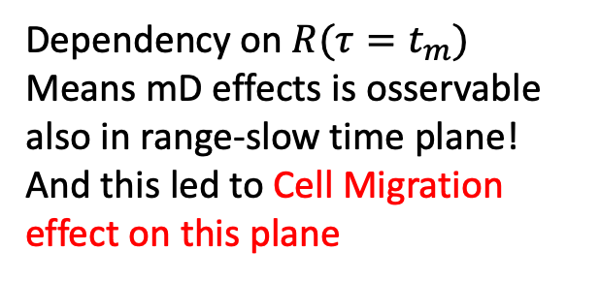

mD in Wideband radar
$$μ=2πB/T$$
Echo from target (Stop and Go model):
In case the radar transmit a LFM signal
The received echo from a target that has also
Rotational movements is :
$$τ:slow time$$
In a FMCW, to extract frequency information
the dechirp operation is performed. RX signal is multiplied by complex conjugate of reference signal (the transmitted one)
$$γ=B/T$$
[1]
It turn into a narrowband signal
Making Fourier Transform (considering
the beat signal is observed in short time)
Dependency on $R(τ=t_{m})$
Means mD effects is osservable also in range-slow time plane! And this led to Cell Migration effect on this plane
[1]
[1] Changzhan Gu, and Jaime Lien,
Short Range Micro Motion Sensing whit Radar Technology. - Cap 5.2.2 - pag.123-124

Slide 6
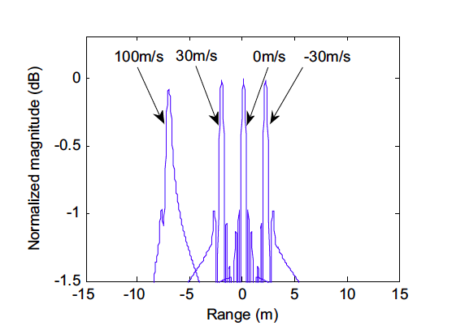
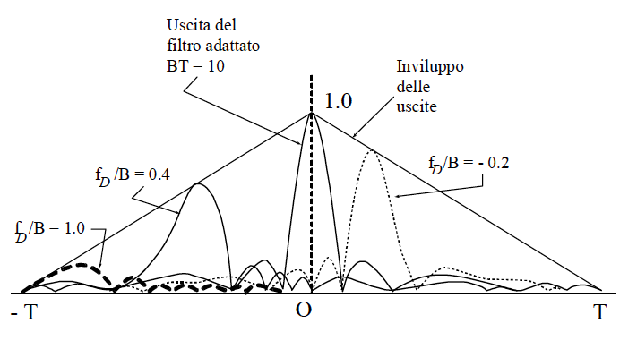


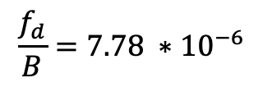

This effect can be neglected?
Cell Migration effect
In a LFMCW radar is not possible to use the Stop and Go model,
Neglecting what happens in intrapulse time led to relative large error such as Cell Migration effect, but…
Considering the pulse compression of LFM, the doppler mismatch at output of MF led to cell migration effect
If the ratio $\frac{f_{d}}{B}<0.05$ is possible to neglect it!
In our case (X-band) : $λ=0.0333 m$
$$B=750MHz$$
$$\frac{f_{d}}{B}=7.78 ∗{10}^{−6}$$
Typical velocities of a drone: $v_{body}=100 km/h { v}_{blade tip}=350 km/h$

Slide 7



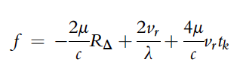




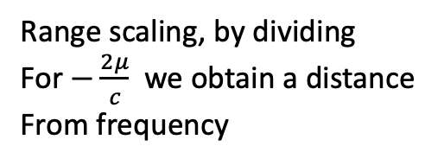
Cell Migration effect
Received signal from target with
Considering a LMFCW radar, and by using Frist Order approximated model it’s possible to compute the migration due to the velocity of target
It’s possible to compute frequency as usual by deriving the phase
By dechirp operation:
[2]
Range scaling, by dividing
For $−\frac{2μ}{c}$we obtain a distance
From frequency
In our case (X-band) : $λ=0.0333 m$
$$B=750MHz$$
V of blades = 350 km/h
Displacement result in
About 3 millimeter
Dipende dai parametri del radar
Se uso un PRI di 1 ms forse si ha migrazione della cella
[2] QUN ZHANG, YING LUO, YONG-AN CHEN. MICRO-DOPPLER CHARACTERISTICS OF RADAR TARGETS. Cap. 3.4 – Pag.63-68

Slide 8
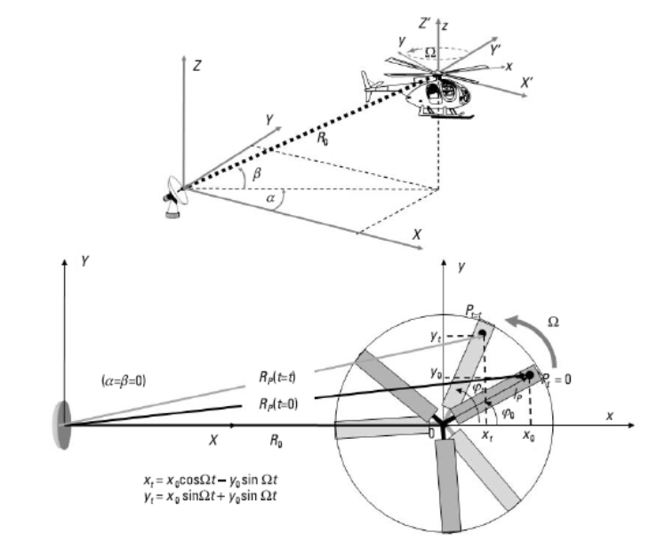




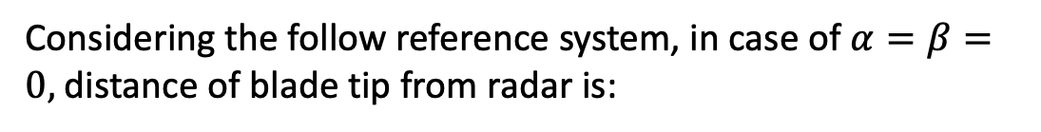
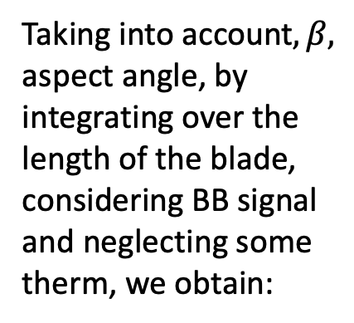
Received signal model from rotor blades
Considering the follow reference system, in case of $α=β=0,$distance of blade tip from radar is:
(Taylor approx. + trigonometric formulas)
The received signal from it is:
Taking into account$,β,$ aspect angle, by integrating over the length of the blade, considering BB signal and neglecting some therm, we obtain:
with
At the end the doppler frequency is, as we expect:
By deriving the phase and using subtraction formulas of sin

Slide 9
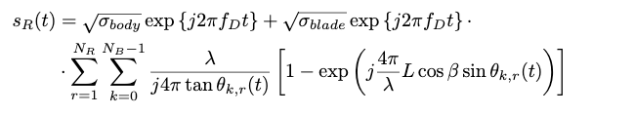
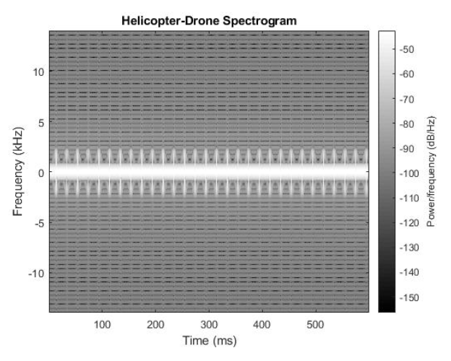
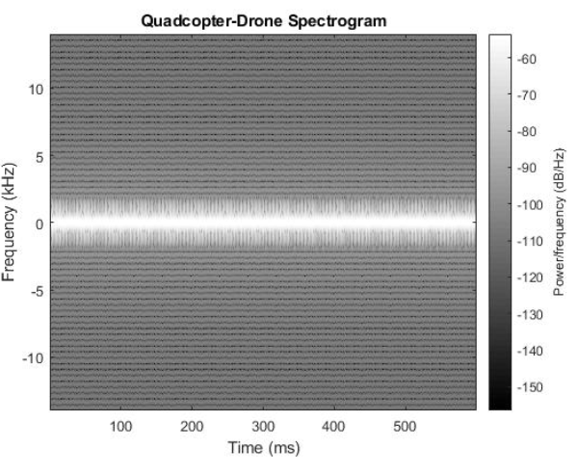
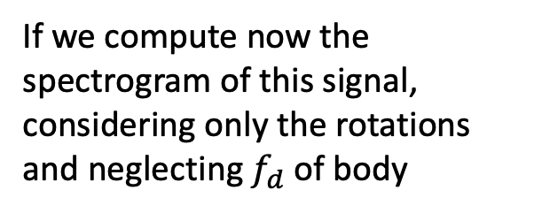
Received signal model from generic target
Considering the summation of each blades and each rotors and doppler frequency of body
If we compute now the spectrogram of this signal, considering only the rotations and neglecting $f_{d}$ of body
Vertical line are called Blade Flash:
When the blade is perpendicular to radar has its max value
Much closer blade flash, due to higher rotation rate
And consequent lower Tc

Slide 10


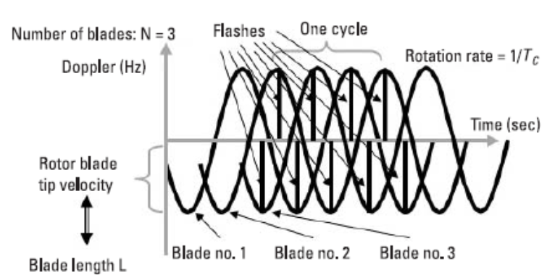

Futures extraction from spectrogrm
Number of blades, if these are odd or even
Rotation rate of blades
Velocity of blade tip
Length of blade
Where Tc is the time distance between two blade flash
All these informations depends on measured Doppler Frequency, consequently only if there is sufficiently resolution in frequency and time its possible to see them!

Slide 11

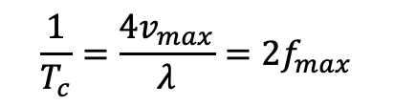




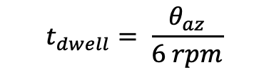
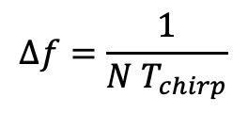
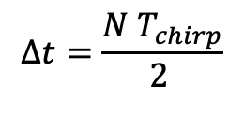
Radar parameters
M: Number of ramps on tgt
During an observation time
N: Number of samples
Of STFT window
In order to be able to capture all the informations relative to mD analysis, is possible to consider that it is necessary to observe at least 5 consecutive blade flashes
Translated into parameter requirements:
$$t_{dwell}= \frac{θ_{az}}{6 rpm}$$
$$t_{dwell}=M{ T}_{chirp}$$
$$t_{dwel_min}=5 T_{c}$$
$Δt= T_{c}$/5
Mapping to FMCW radar
$$Δt=\frac{N{ T}_{chirp}}{2 }$$
Due to shift of STFT window of
N/2 samples per time
$Δf= f_{max}$/5
$$Δf=\frac{1}{N{ T}_{chirp}}$$
Another constraint come from maximum velocities measurements
Frequency resolution of SFTF, not
Overall
$v_{max}$ $=\frac{λ}{4T_{c}}$
$$\frac{1}{T_{c}}=\frac{{4v}_{max}}{λ}=2f_{max}$$

Slide 12


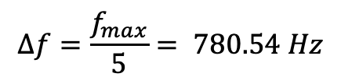
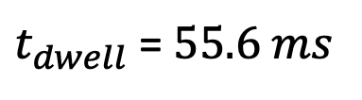
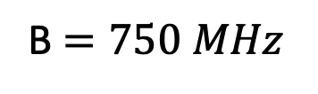





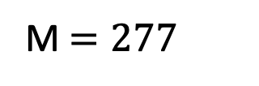




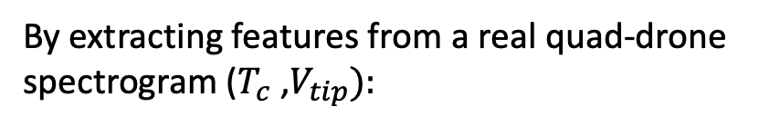

Verification of constraint
Taking into account the previous FMCW radar
designed parameters in power budget:
By extracting features from a real quad-drone spectrogram ($T_{c}$ ,$V_{tip}):$
$$T_{c}=5 ms$$
$$V_{tip}=65 m/s$$
$t_{dwell}$ = $55.6 ms$
In order to see at least 5 consecutive blade flash:
$$t_{chirp}=0.2 ms$$
Our is 55 ms
$$t_{dwel_min}=25ms$$
M $=277$
$$f_{max}=3,9027 KHz$$
From ${2V}_{tip}/λ$
B $=750 MHz$
$Δt= T_{c}$/5 = 1 ms
By knowing $t_{chirp}$
$f_{0}$ $=9 GHz$
$$Δf=\frac{f_{max}}{5}= 780.54 Hz$$
N = $2Δt/t_{chirp}$ =10
$$R_{max}=1000 m$$
Setting length of STFT window to 10, $Δf$ is equal to 500 Hz

Slide 13
Next phases
Reduce as much as possible the requirements of radar
needed to see microdoppler effects
Spectrum analysis:
Mapping of microdoppler effects on the spectrum of received signals
Write steps done on thesis
Modello segnale ricevuto dalla pala, congiunzione tra I due modelli
Aggiugnere parametri al segnale
Matlab dati I parametri e I constraints restituisce forma d’onda compatibile
Ricerca modelli droni
Thanks for attention!

